Slide 1
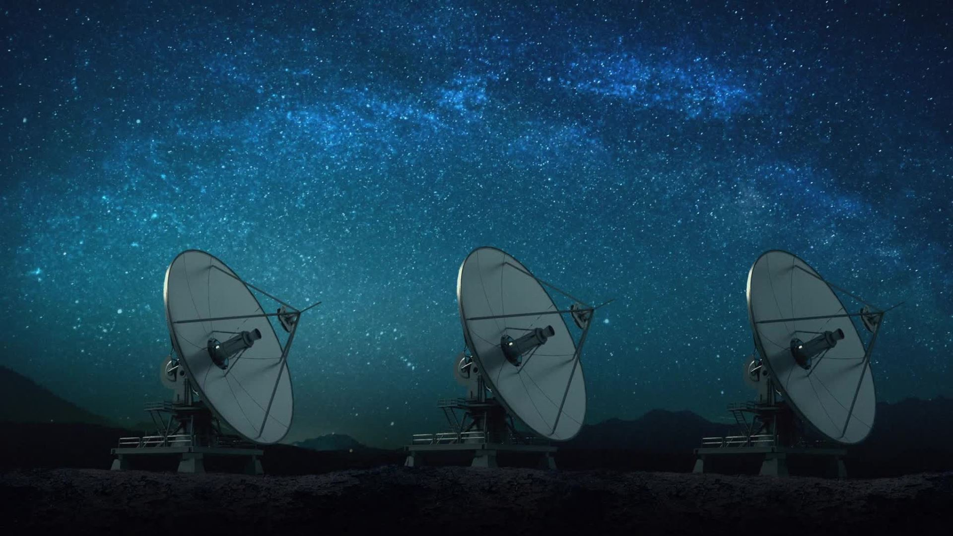
GROUND STATION FOR TRACKING LoRa SATELLITES
Name(s) - Gurnoor Kaur & Gurpuneet Singh Hunjan
Roll No(s) - 2302873 , 2339611
Branch & Semester – ECE (6th)

Slide 2
Introduction
Growing demand for IoT and satellite communication
Limitations of traditional wireless technologies
LoRa as a low-power, long-range solution
Use of LoRa in modern CubeSat missions

Slide 3
What is LoRa?
LPWAN technology
Operates in ISM bands (433/868/915 MHz)
Long range, low power
Used in IoT and satellite telemetry
“LoRa uses Chirp Spread Spectrum which allows communication over several kilometers.”

Slide 4
Problem Formulation
Internet & cellular not available everywhere
High power consumption of existing systems
Expensive satellite ground stations
No easy way to monitor satellite health data
“We identified the need for a low-cost, scalable satellite ground station.”

Slide 5
Objectives
Build LoRa satellite ground station
Receive satellite telemetry data
Display real-time parameters
Store long-term data on dashboard
Support future satellite-based IoT
Our main objective is monitoring satellite health using LoRa.

Slide 6
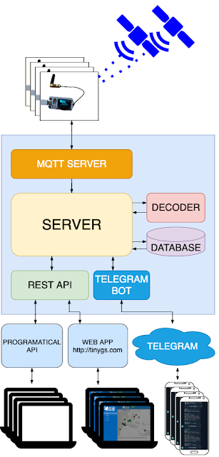
System Overview

Slide 7
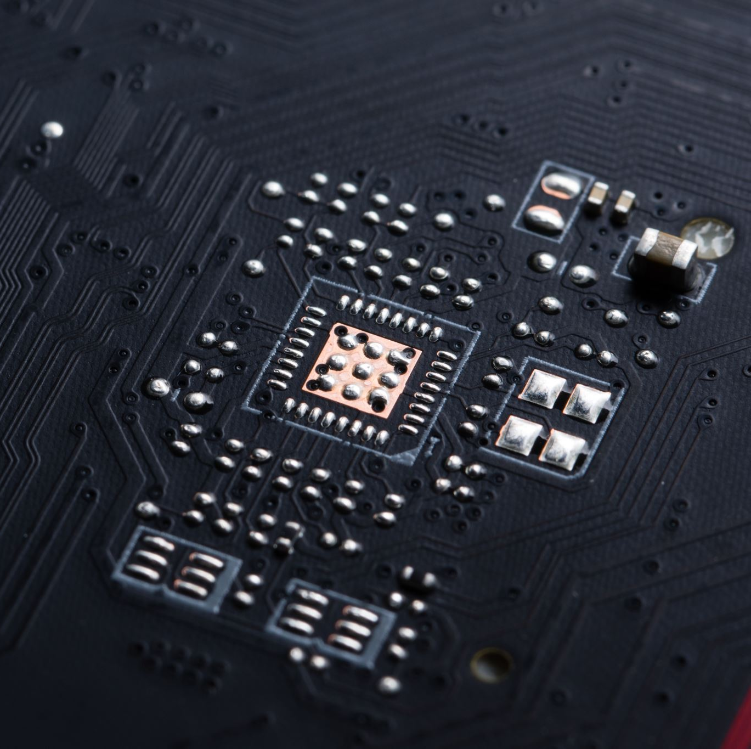
Hardware Components
ESP32
RA-02 LoRa Module
0.95” OLED Display
Buck Converter
PCB
U.FL to SMA Cable
Fabricated Antenna
These components are low-cost and easily available.

Slide 8
Methodology
Hardware interfacing
Antenna fabrication
Firmware flashing (TinyGS)
Frequency auto-tuning
Data reception & logging
The system automatically tunes according to satellite frequency.

Slide 9
Dashboard & Data Monitoring
Battery voltage & temperature
Solar panel voltage
CPU & payload health
Packet success/failure
Satellite tracking history
All data is stored from first day to satellite lifetime.

Slide 10
Applications
Satellite health monitoring
Educational & research use
Satellite-based IoT
Disaster & remote communication
CubeSat missions
This system is useful for both academic and future IoT applications.

Slide 11
Cost & Conclusion
Total cost ≈ ₹5000
Low-cost & scalable
Future-ready technology
Scope for ISRO / academic use
This project demonstrates that satellite communication is possible on a limited budget.

